Slide 1


AUTOMATIC ALARM
USING PIEZO SENSOR

Slide 2
PRESENTED BY:-
GROUP 8
ROUHI RAY(11500319065)
SUPARNA BHOWAL(11500319031)
SUSHMITA SINGH(11500319061)
SHANU MONDAL(11500320094)

Slide 3
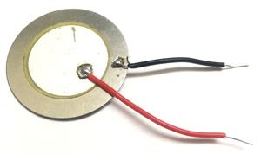
HARDWARE COMPONENTS
PIEZOELECTRIC SENSOR
DIODE
CAPACITORS(10μF)
WIRES
BUZZER

Slide 4
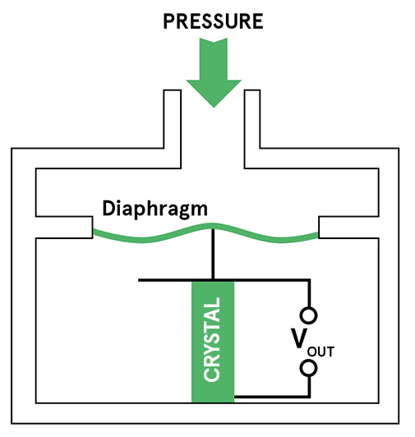
Piezoelectric pressure sensors exploit this effect by measuring the voltage across a piezoelectric element generated by the applied pressure.
When a force is applied to a piezoelectric material, an electric charge is generated across the faces of the crystal. This can be measured as a voltage proportional to the pressure.
PIEZOELECTRIC
SENSOR

Slide 5
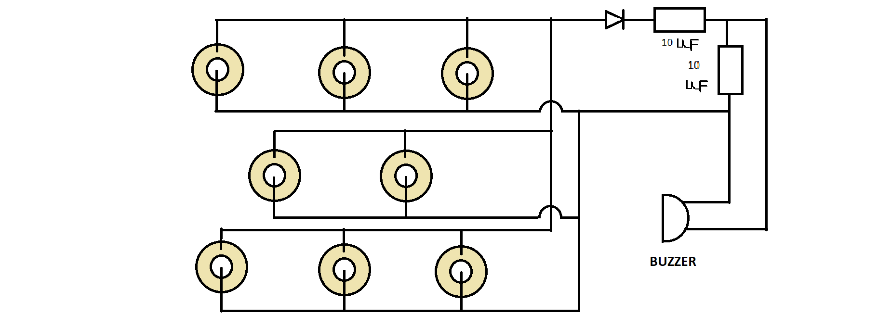
BLOCK DIAGRAM

Slide 6

Implementation of hardware
Getting signals from sensors
WORKING
NO
Is all sensors provide signals
YES
Storing energy via Piezoelectric Sensor
Conversion of energy to electrical energy
Providing electrical energy to device

Slide 7
In the Piezo sensor, a thin membrane is placed on a massive base to transfer the applied force to the piezoelectric element.
Upon application of pressure on this thin membrane, the piezoelectric material gets loaded and starts generating electrical voltages. The produced voltage is proportional to the amount of pressure applied. The electrical energy makes the buzzer on.
OUTCOME

Slide 8
APPLICATIONS
Safety Purpose
Ultrasonic equipment
Alarm clocks
Musical instruments

Slide 9
CONCLUSION
Piezoelectric Sensor is an effective and efficient new vibrational source which can be used as suitable renewable energy source.

Slide 10
REFERENCES
https://nevonprojects.com/peizo-based-visitor-sensing-welcome-mat/
https://www.elprocus.com/what-is-a-piezoelectric-sensor-circuit-specifications-and-applications/
https://issuu.com/ijsrd/docs/ijsrdv4i11174
MARADAMMA Y, RAJIV K, NISSARAHMAD N, SATTYASHREE M, KANDAGAL S. S, 26th June, 2016, “GENERATION AND STORAGE OF ELECTRICITY BY AMBIENT VIBRATIONS AND PRESSURE BY USING PIEZOELECTRIC DEVICES”, ICITER-C117

Slide 11


